Slide 1

Satellite era observations

Slide 2
Satellite era
Need for satellite data
Spatial coverage
Uniformity of observations
First satellite – Seasat (1978)
Ocean data from 1979 onwards
First Indian satellite for ocean observations: Oceansat – I (1999)
Oceansat – I carried Ocean Colour Monitor (OCM)
http://www.jpl.nasa.gov/images/spacecraft/seasat/craft2-browse.jpg

Slide 3
Satellite data
Different types of remote sensing techniques such as optical, thermal, microwave
Satellites can orbit the Earth several times a day. It is possible to obtain data from a large region (almost the entire world) in a short amount of time.
Instruments can give surface temperature, salinity, sea surface height, winds, currents, chlorophyll
Active RADAR system which measures altimeter
Microwave imaging/ Infrared imaging

Slide 4
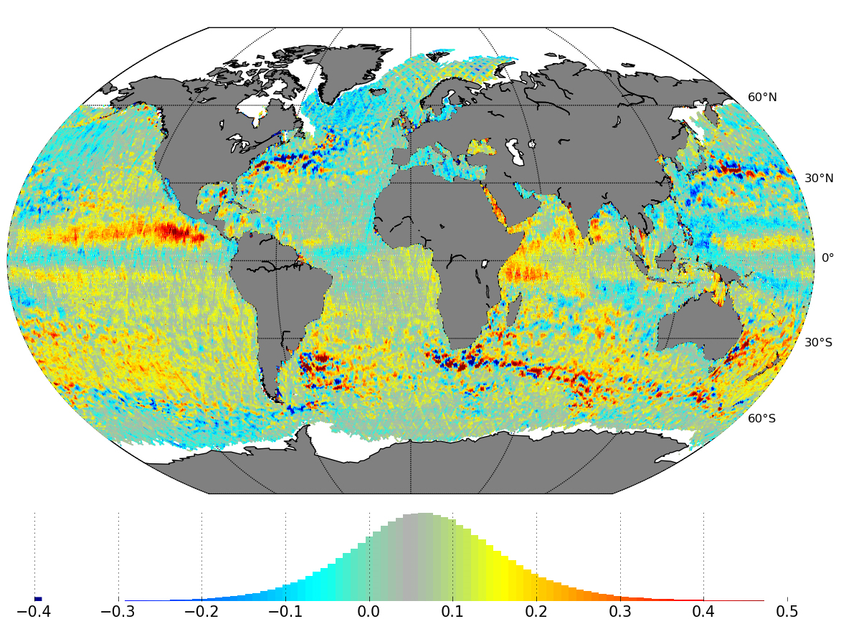
Radar
Satellite radar altimetry measures the time taken by a radar pulse to travel from the satellite antenna to the surface and back to the satellite receiver.
Sea level changes
Sea floor topography
https://www.star.nesdis.noaa.gov/socd/lsa/AltBathy/
http://www.esa.int/spaceinimages/Images/2016/05/Sea-level_variations_from_Sentinel-3A

Slide 5
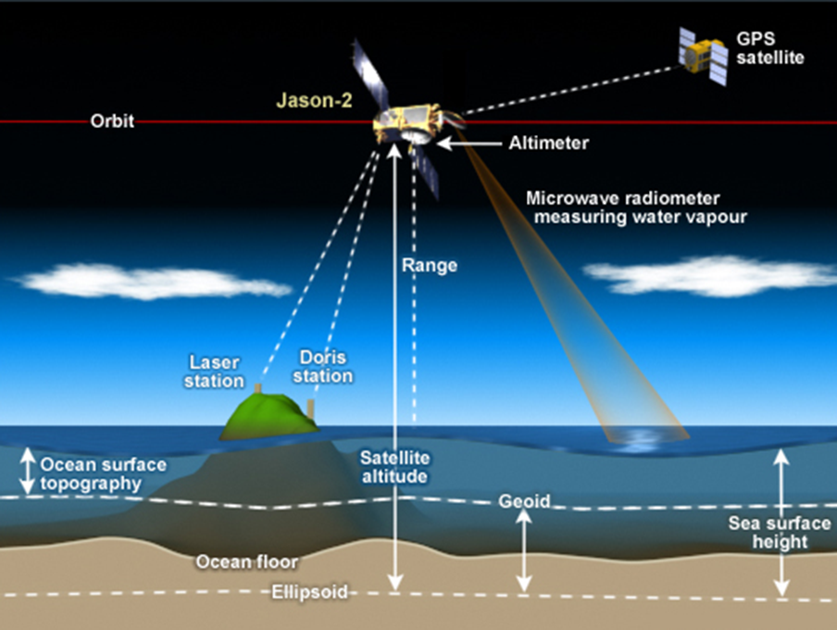
https://www.star.nesdis.noaa.gov/socd/lsa/AltBathy/
https://podaac.jpl.nasa.gov/OceanSurfaceTopography

Slide 6
Ocean temperatures, salinity & currents
Satellite microwave radiometers, infrared (IR) radiometers measure sea surface temperature
Salinity is estimated by measuring the blackbody radiation of the sea surface.
Radar altimetry measures sea-surface topography, and is used to derive estimates of geostrophic currents over a period of about 10 days.
To improve the accuracy and to validate estimates of ocean currents from ocean models, it is important to combine satellite observations with in situ data sources provided by drifting buoys and ships.
Radiometry measurements are used to derive ocean colour
Wide spatial range and temporally uniform, but not enough subsurface data
Satellite data must be supplemented with in situ buoy data especially in the case of ocean currents.
https://oceanservice.noaa.gov/facts/satellites-ocean.html

Slide 7
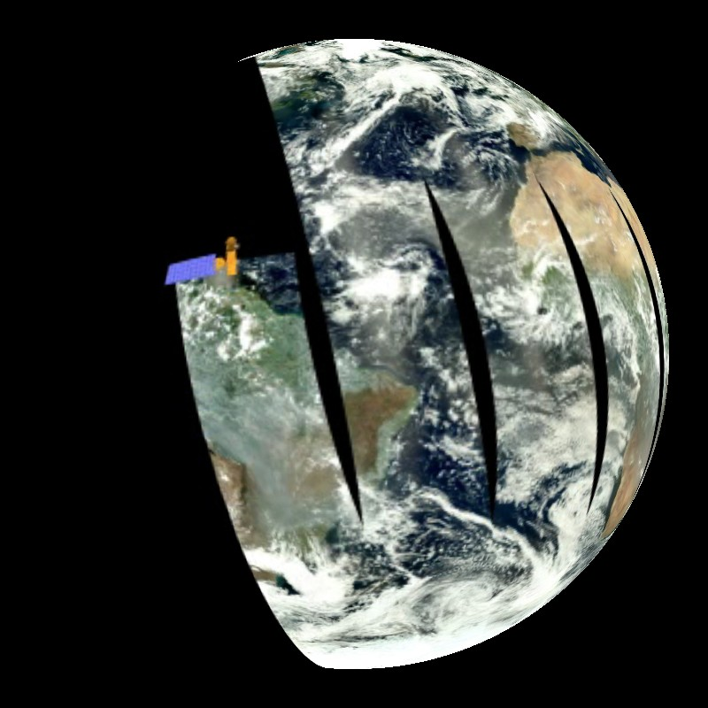
Satellite orbits
Polar orbiting
Geostationary
https://sos.noaa.gov/ftp_mirror/atmosphere/aqua_swath/media/thumbnail_big.jpg

Slide 8
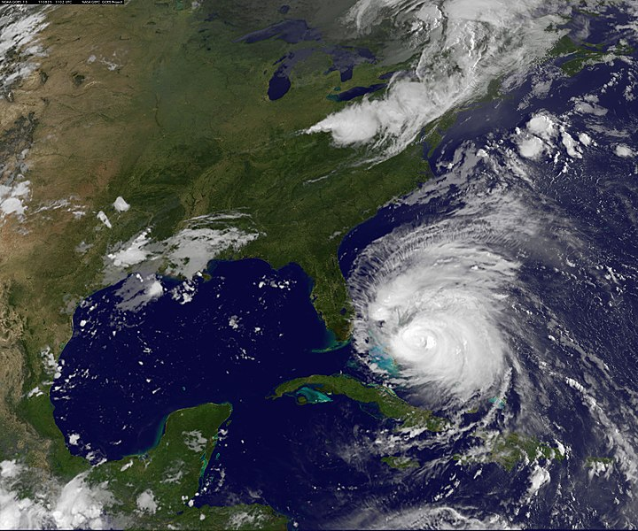
NASA / NOAA GOES-13 satellite image showing Hurricane Irene on August 25, 11:02 UTC.
https://www.flickr.com/photos/gsfc/6079550294/

